Slide 1
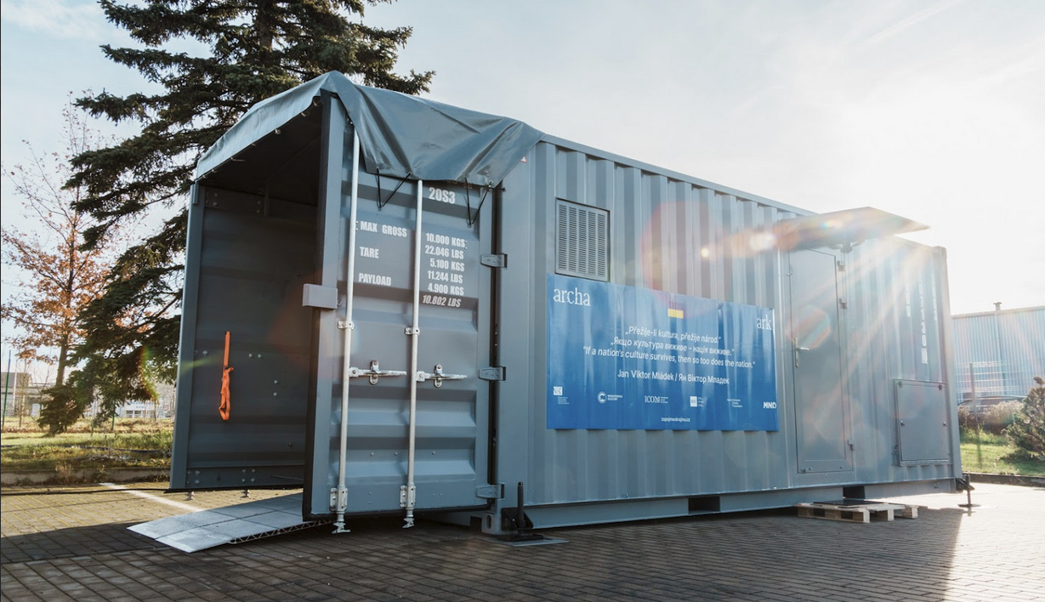
ARK I : mobile unit for the preservation of the book cultural heritage

Slide 2
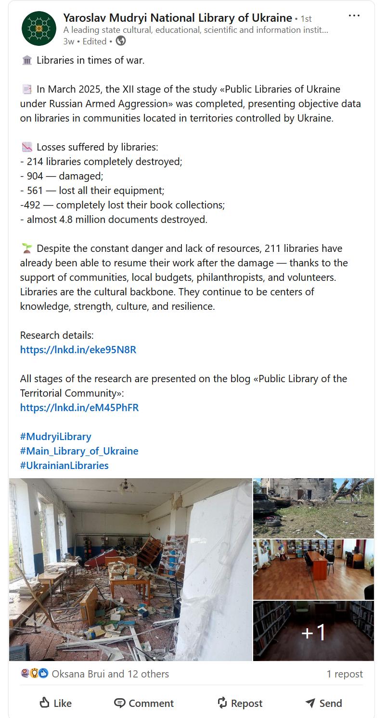
https://www.linkedin.com/posts/yaroslav-mudryi-national-library-of-ukraine-bb5378265_mudryilibrary-mainabrlibraryabrofabrukraine-activity-7333549419092434944-JUDe?utm_source=share&utm_medium=member_desktop&rcm=ACoAAAVu_0kBJ92vCkZ-7RuEQy1JM6YThTs2INk

Slide 3






Základní informace / Project highlights
10 500 000 CZK | 422 000 €
Total costs of the project.
6 project partners
Representatives of the governmental sector, private supporters and professional organisations.
January – December 2024
Timeline of the project.
Yaroslav Mudryi National Library of Ukraine and Ukrainian Library Association
Ukrainian project partners.

Slide 4
The path to the the unit creation
2007 - 2023
From the first ideas and plans to the first project steps
8/2024
First 3D model and visualization available
10/2024
Memorandum of Mutual
Cooperation
12/2024
Mobile unit is delivered to the National Library of the Czech Republic premises in Prague Hostivař
5-6/2023
First designs and technical drawings of the mobile unit
6/2024
Four-day training and for Ukrainian culture heritage institutions professionals
11/2024
Final mobile unit quality check
1/2025
Ark I transported to Kyiv and officially handed over
to the Director of the Yaroslav
Mudryi National Library
Notes:
Thank you. I'd like to begin with timeline of project Ark one. The idea of creating a mobile workplace has been developing for many years, as the timeline in the picture suggests. You can see the key moments in the implementation here. After the project began, it was necessary to complete the implementation part of the design and it was possible to implement the construction of the workplace. A memorandum of cooperation was signed. Workplace construction inspections were underway. At the same time, small equipment was purchased and training was carried out. Finally, the container was completed and transported to Ukraine.

Slide 5
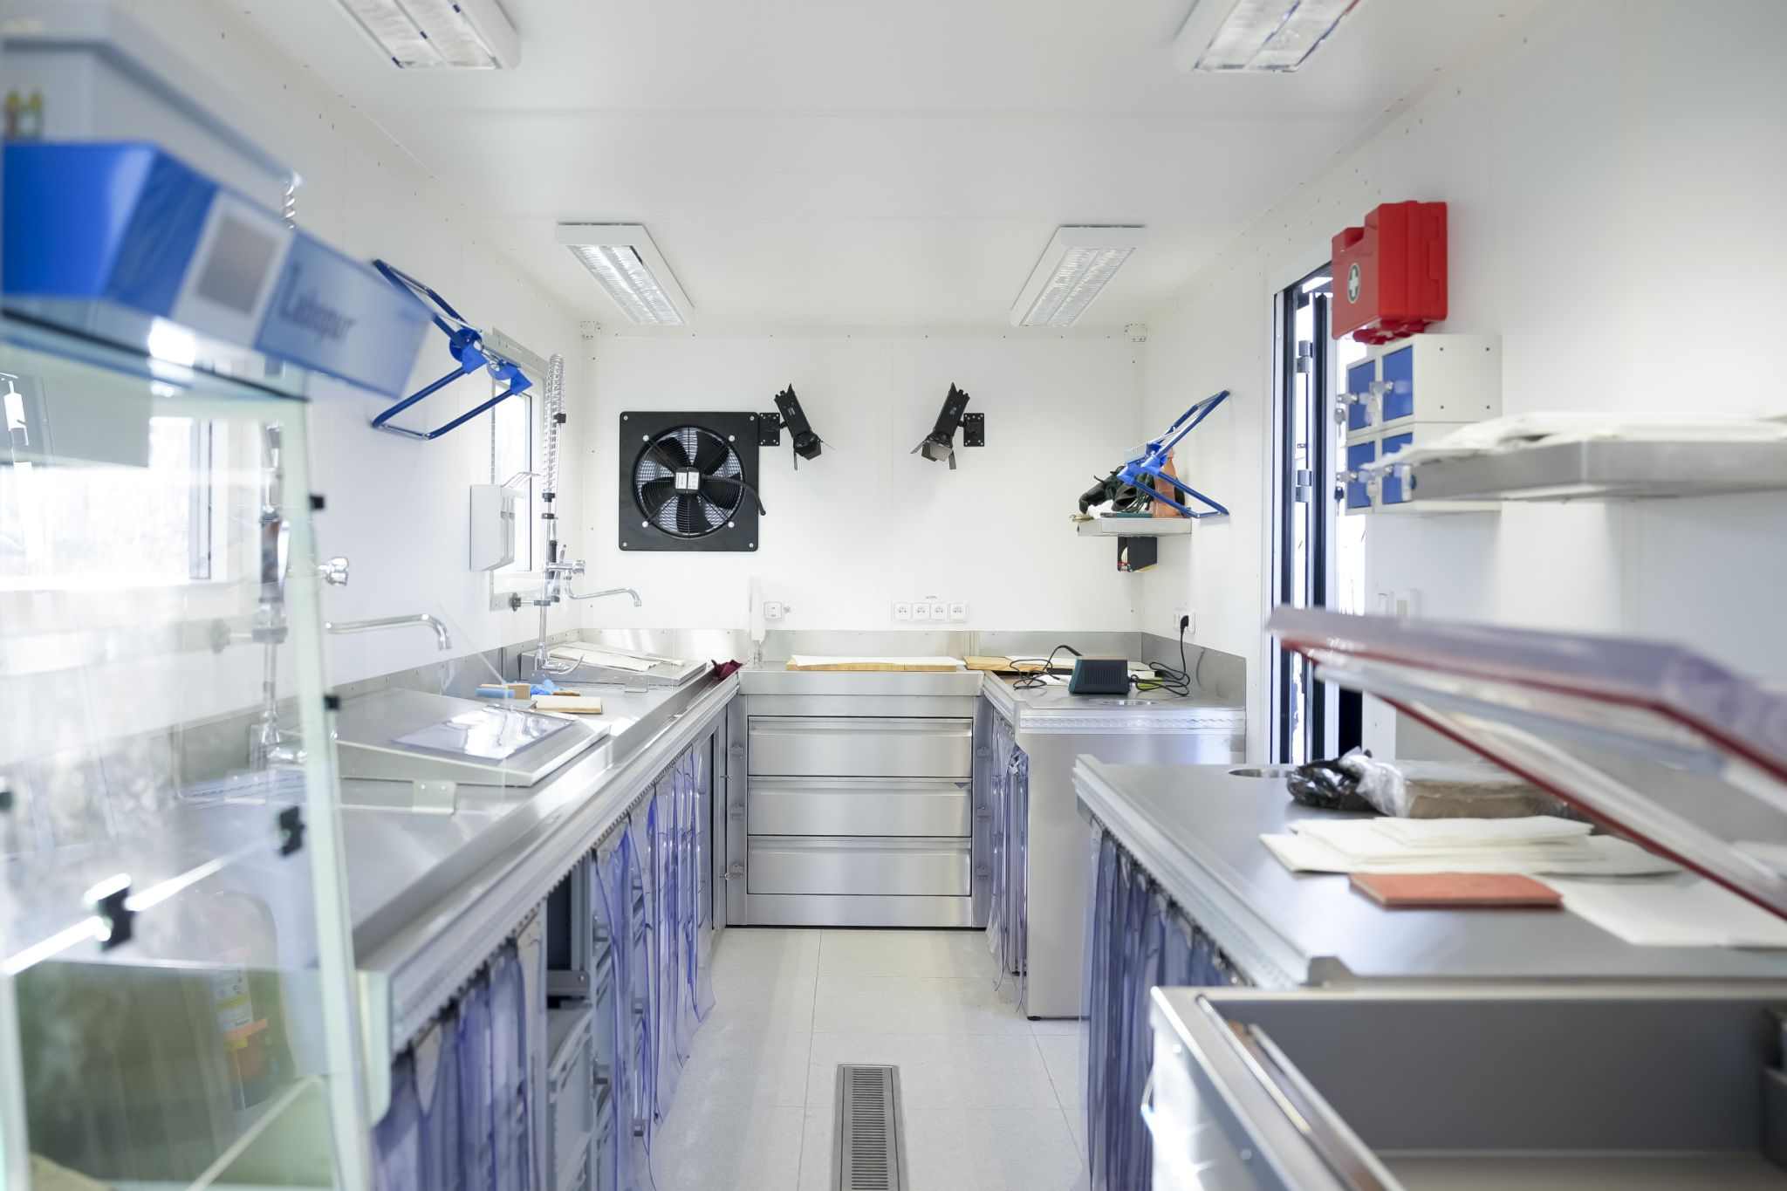
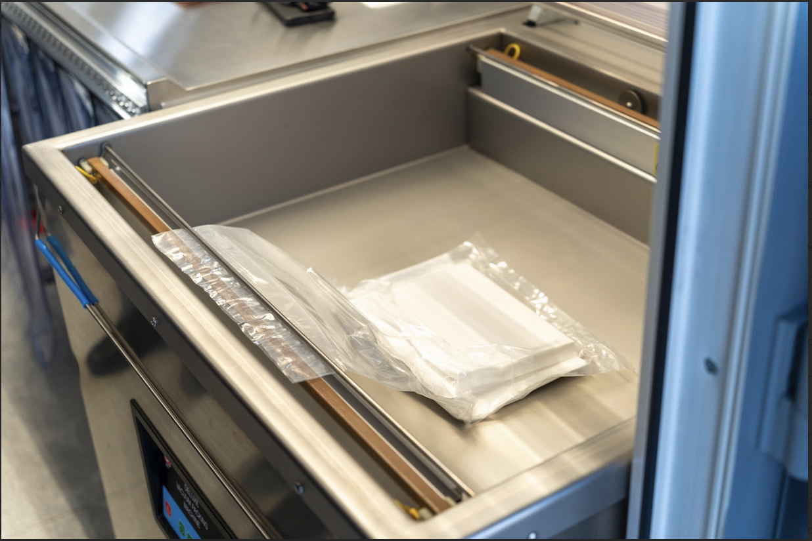
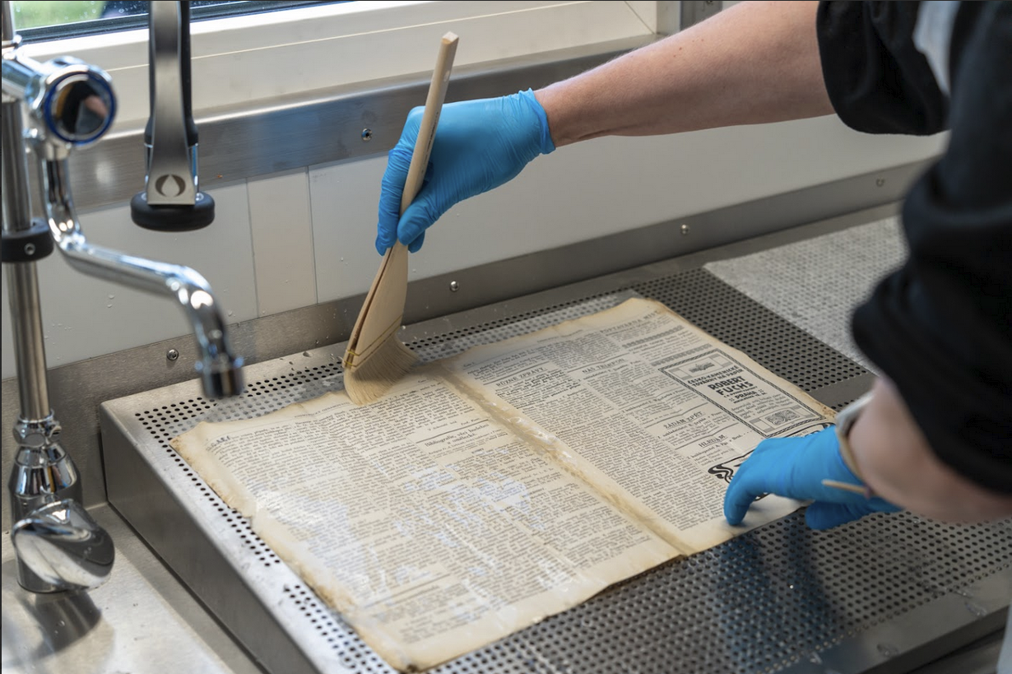
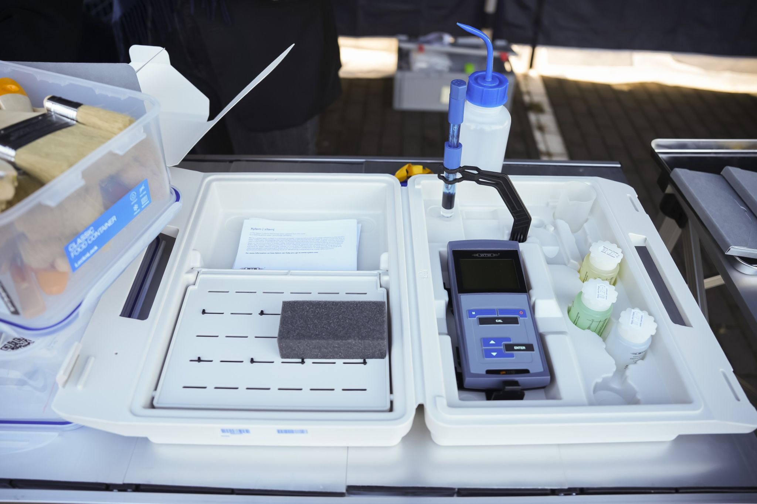
IT equipment
laptops, studio LED lights, digital
Handling equipment
transport trucks, loading blocks, cleaning supplies (bags, sponges, etc.), packaging material etc.
Professional equipment for cleaning and protection
pH meters, pH electrodes, vacuum cleaners, restoration lamp with magnifying glass
Notes:
Equipment for documentation, repair and cleaning, protective aids and transport equipment have been purchased separately. They were stored in grey boxes for easy transport into the building. It is planned that the libraries will carry out some activities outside the mobile unit.

Slide 6
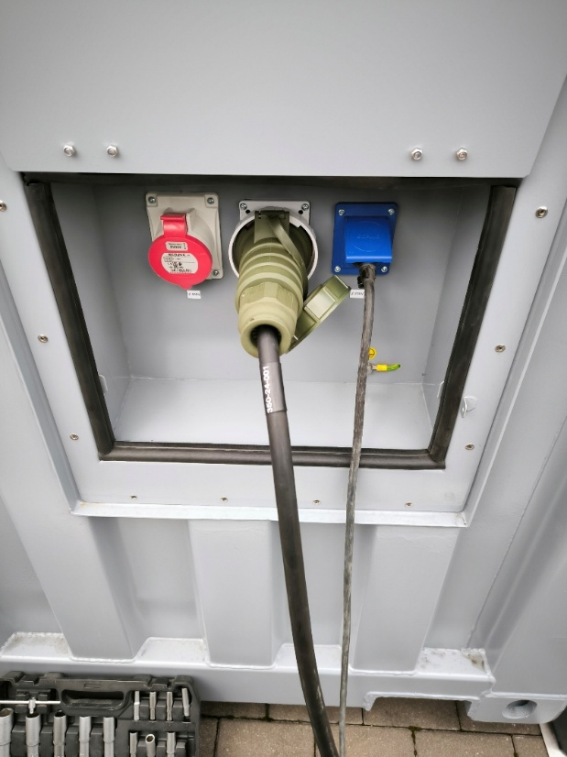
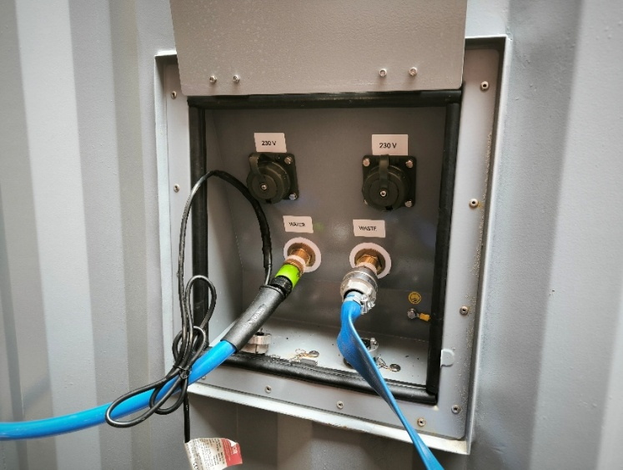
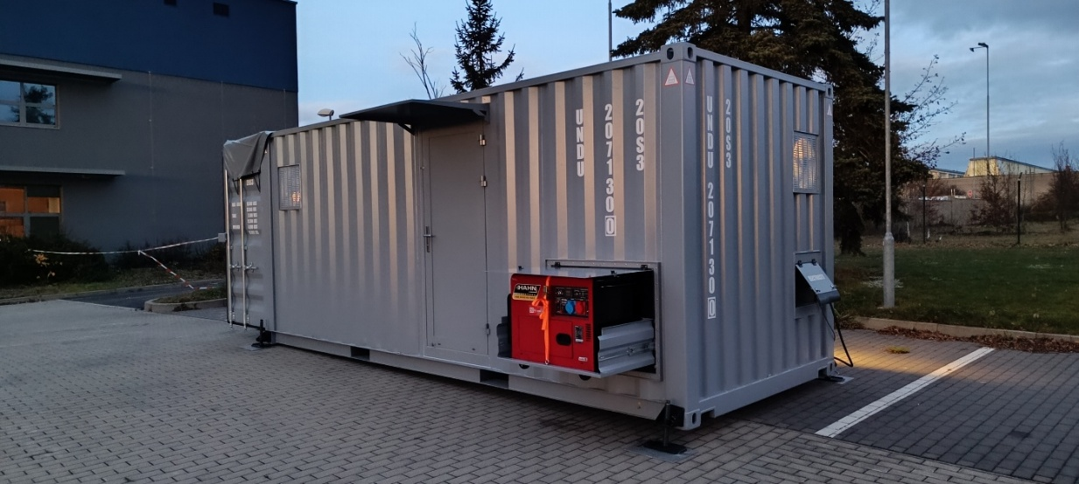
The mobile unit can be interconnected to the water and energy supplies
Cold and hot water supply and waste removal from the sink.
Combined filter for mechanical impurities larger than 50 micrometers.
Diesel generator 6 kW.
Possibility of external connection of electricity supply.
Notes:
Equipment for documentation, repair and cleaning, protective aids and transport equipment have been purchased separately. They were stored in grey boxes for easy transport into the building. It is planned that the libraries will carry out some activities outside the mobile unit.

Slide 7
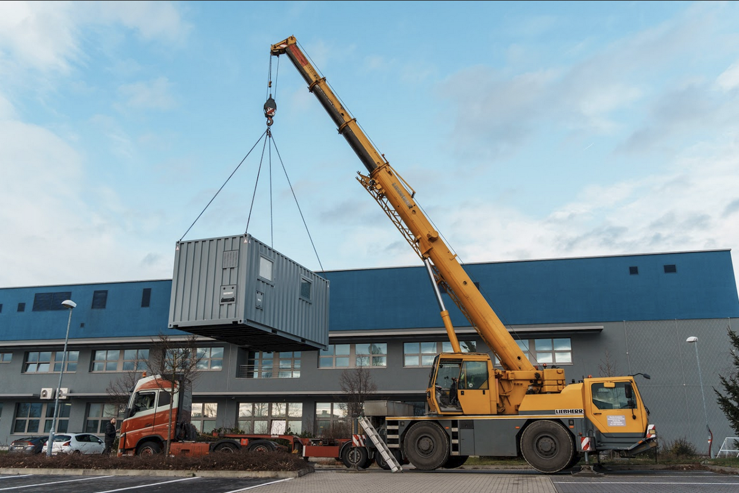
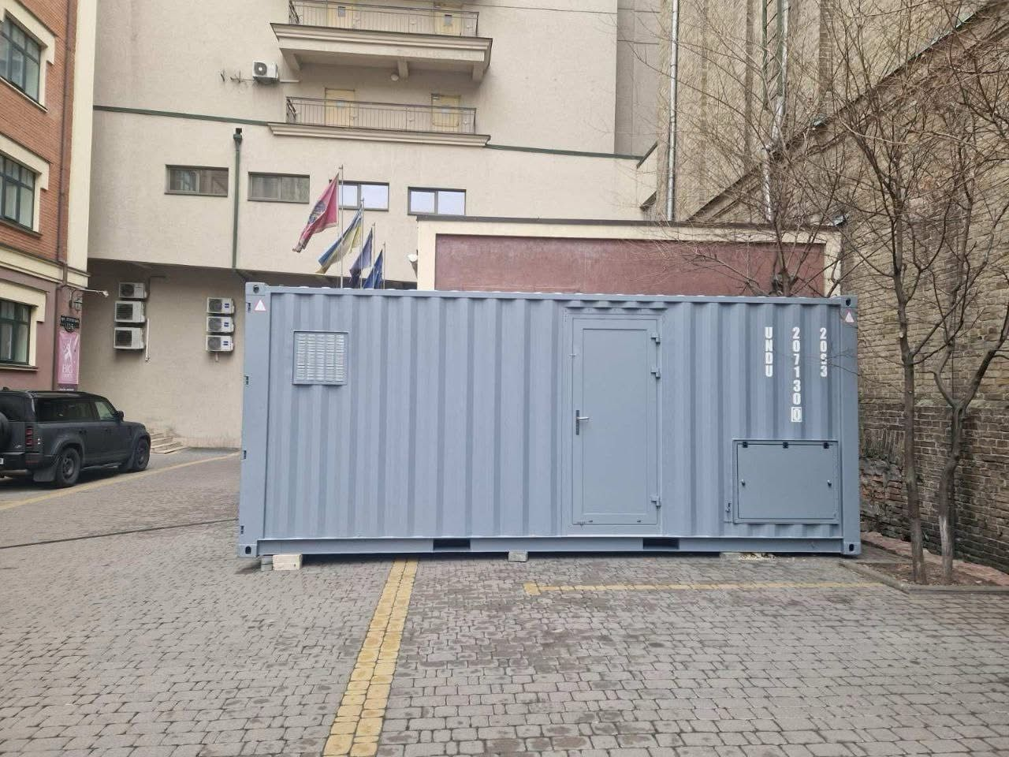
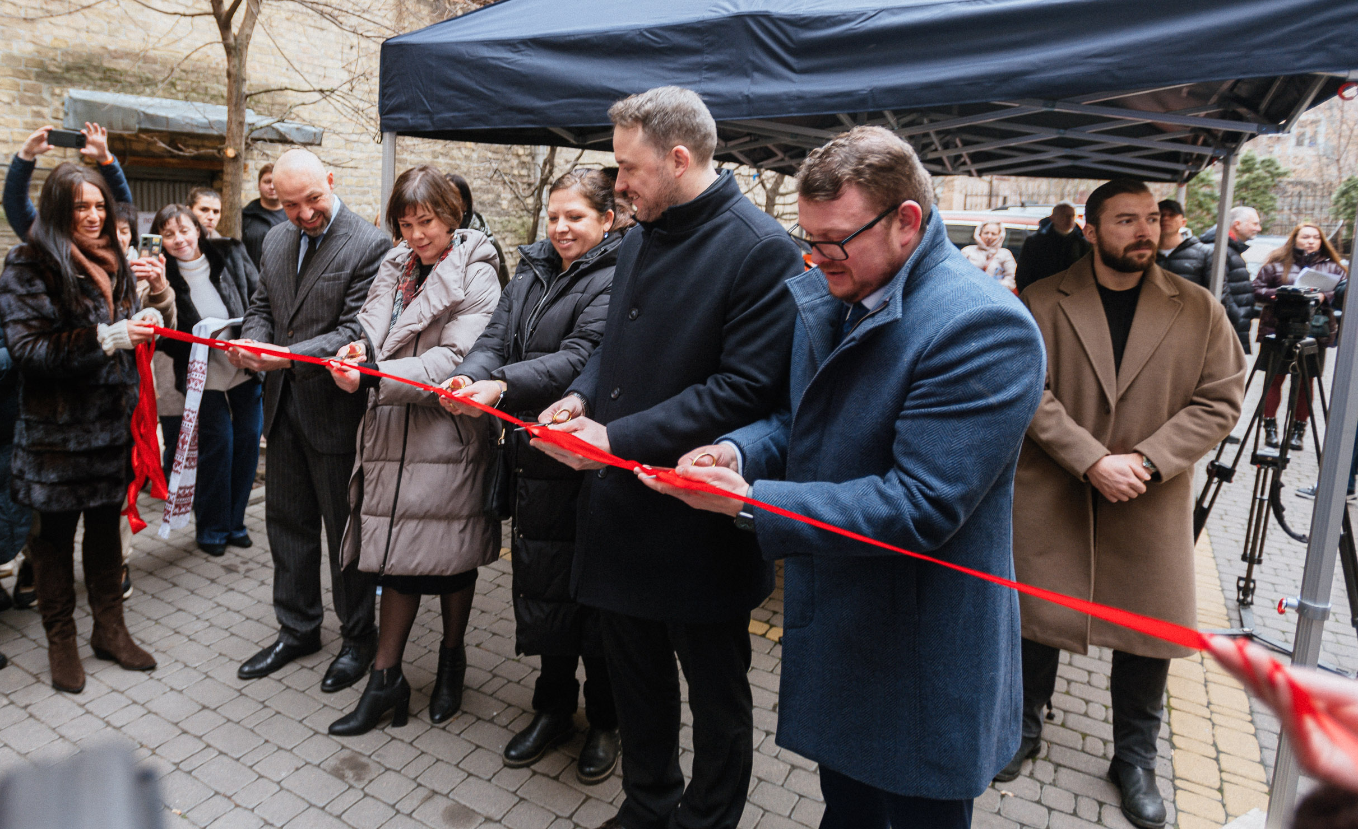
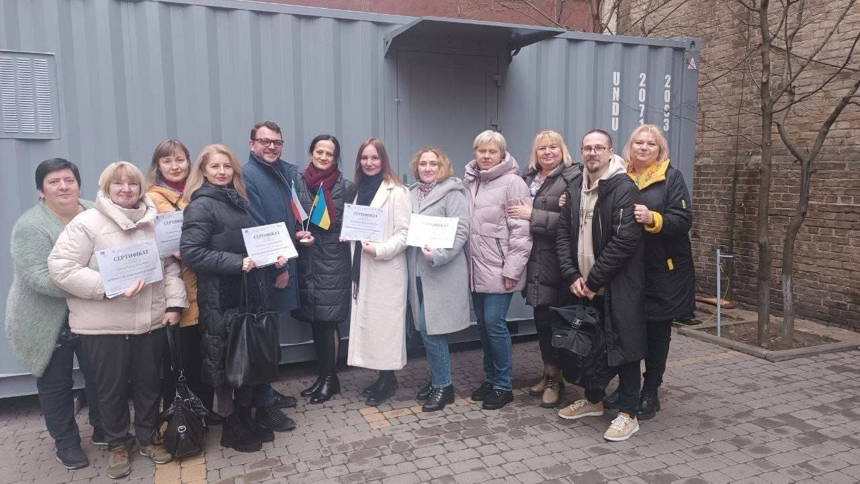
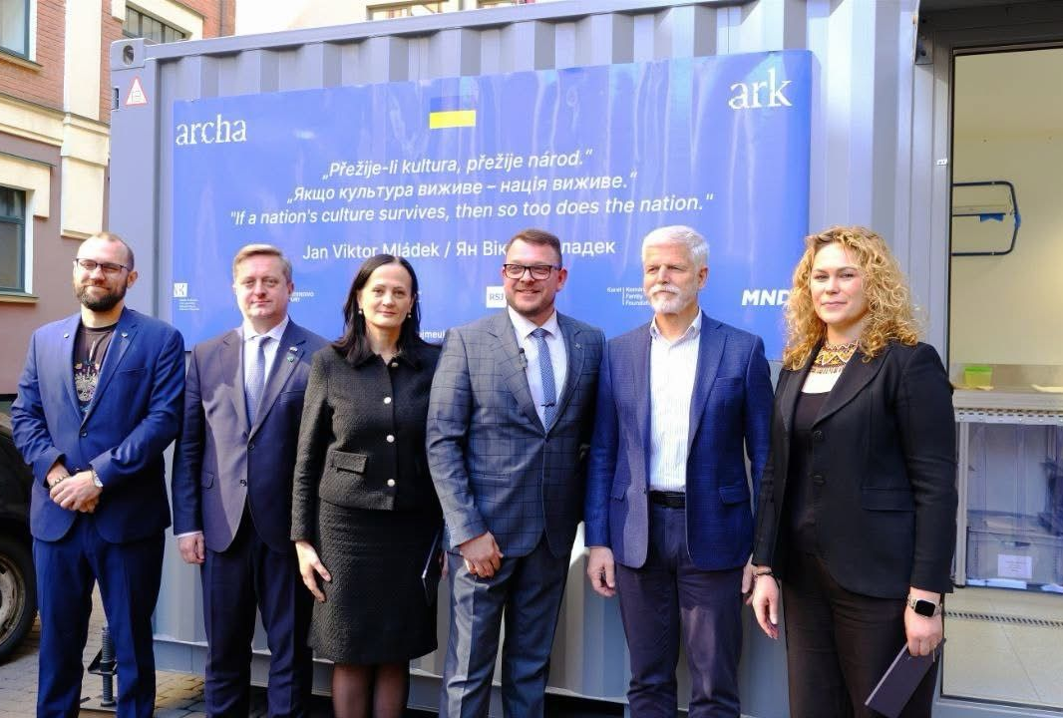
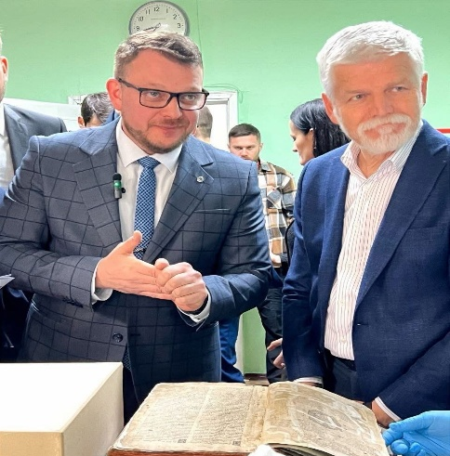
The mobile unit is fully operating in Ukraine
27. 1. 2025
Official grand opening of the mobile unit in Kyiv.
Participation of VIP guests and great interest of the media.
Extensive staff Training.
Visit of the President of the Czech Republic.
Notes:
Equipment for documentation, repair and cleaning, protective aids and transport equipment have been purchased separately. They were stored in grey boxes for easy transport into the building. It is planned that the libraries will carry out some activities outside the mobile unit.

Slide 8
