Slide 1
Programming and debate
Bremen, June 24, 2025
what role can public libraries play?

Slide 2
What impact do you want to make with your programming?
“If you are neutral in situations of injustice, you have chosen the side of the oppressor. If an elephant has its foot on the tail of a mouse, and you say that you are neutral, the mouse will not appreciate your neutrality.” – Desmond Tutu
Bremen, June 24 2025
How do you look at your library?

Slide 3
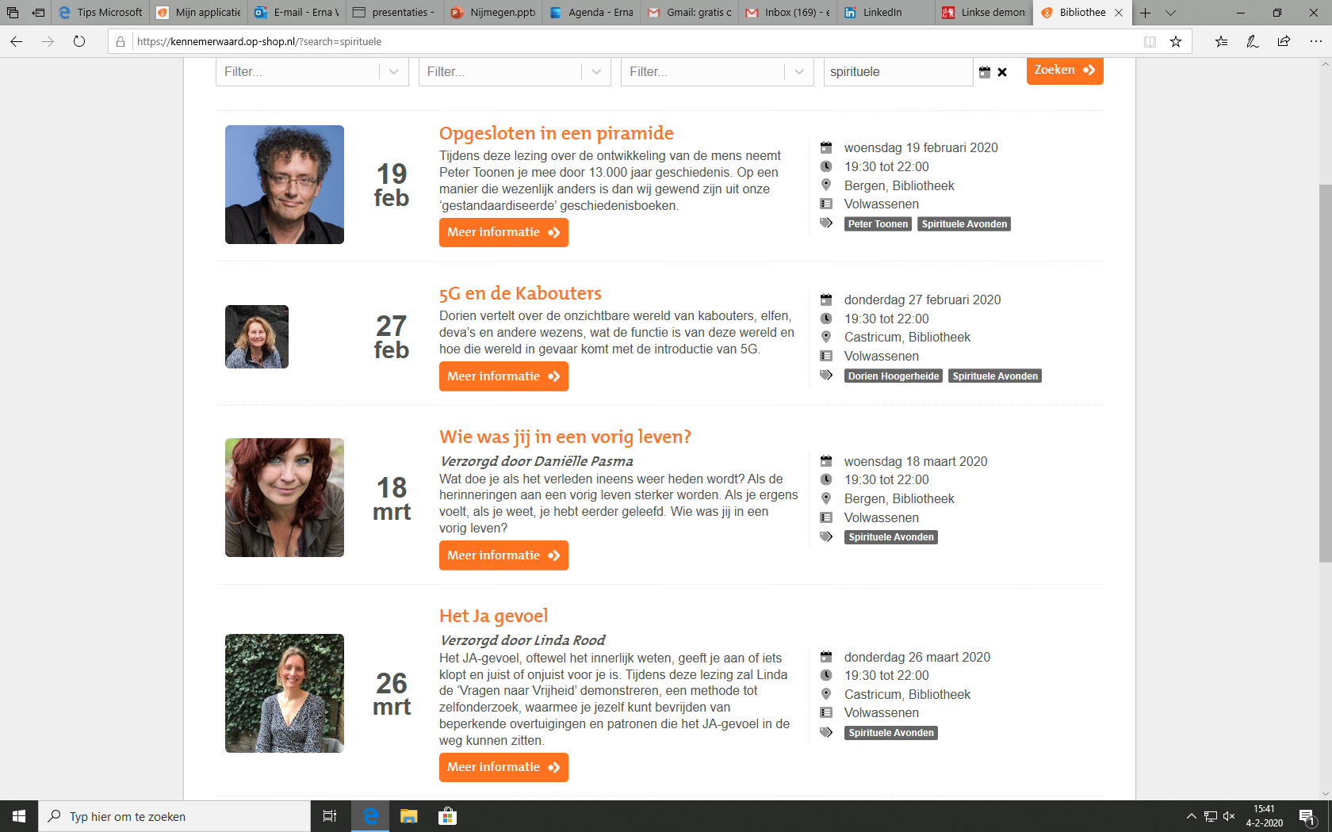
‘Save’ progamming?

Slide 4
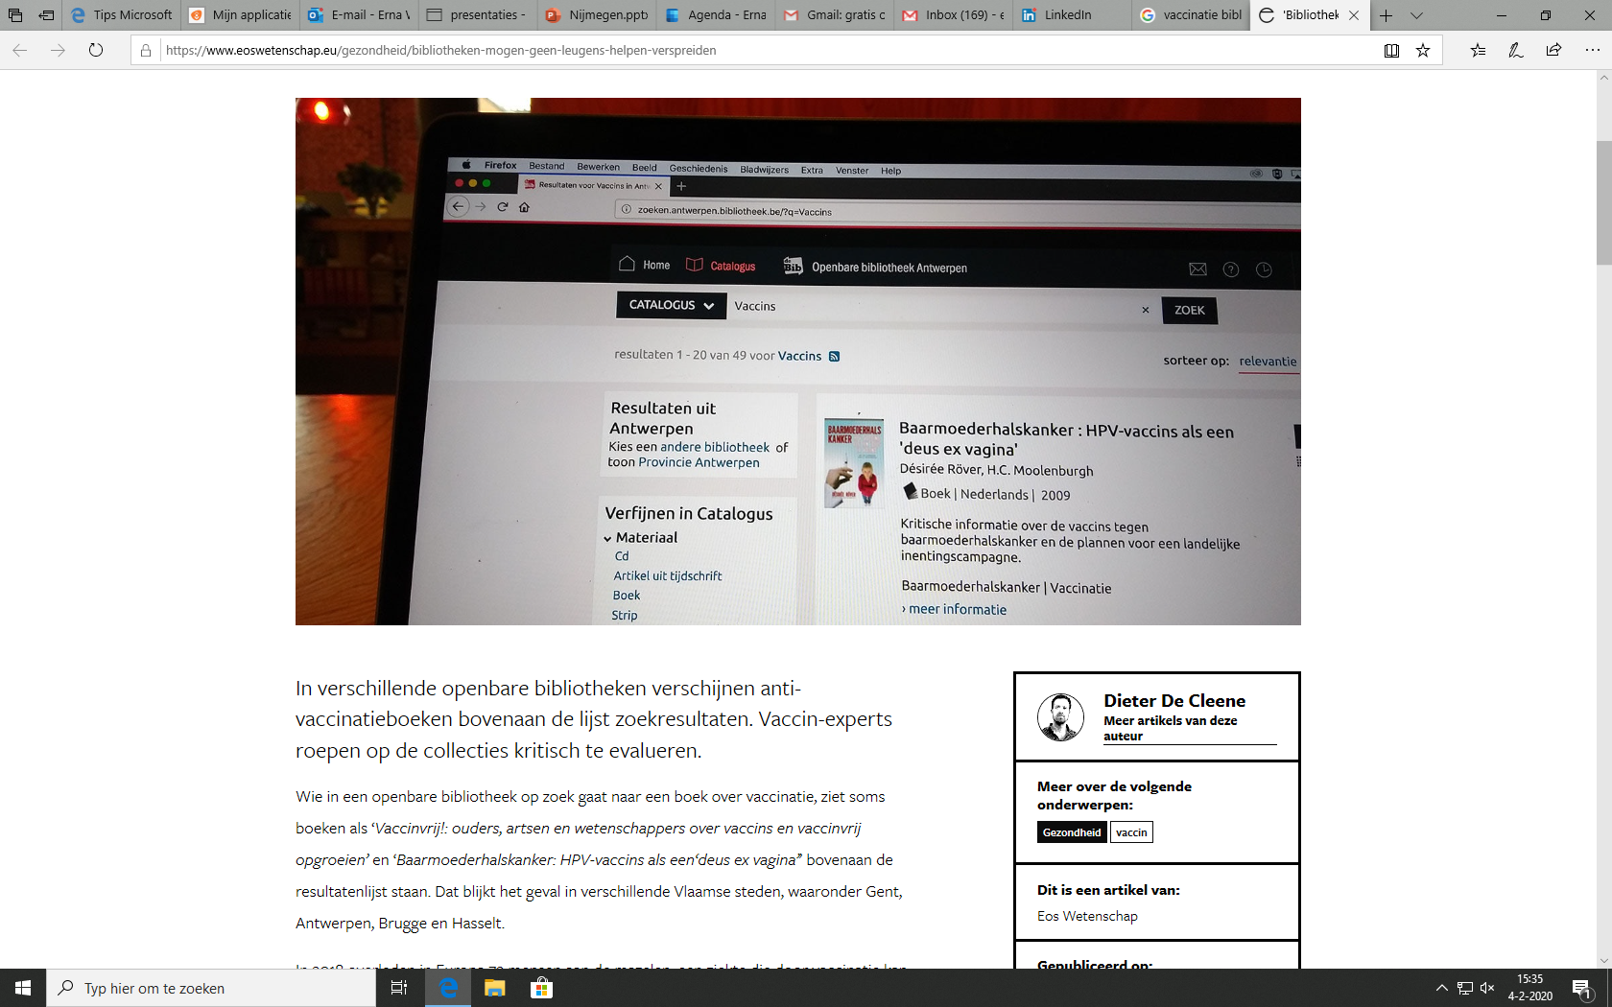
Or less ‘save’, when will it start to itch?

Slide 5

Discussions on censorship

Slide 6

Inclusion

Slide 7
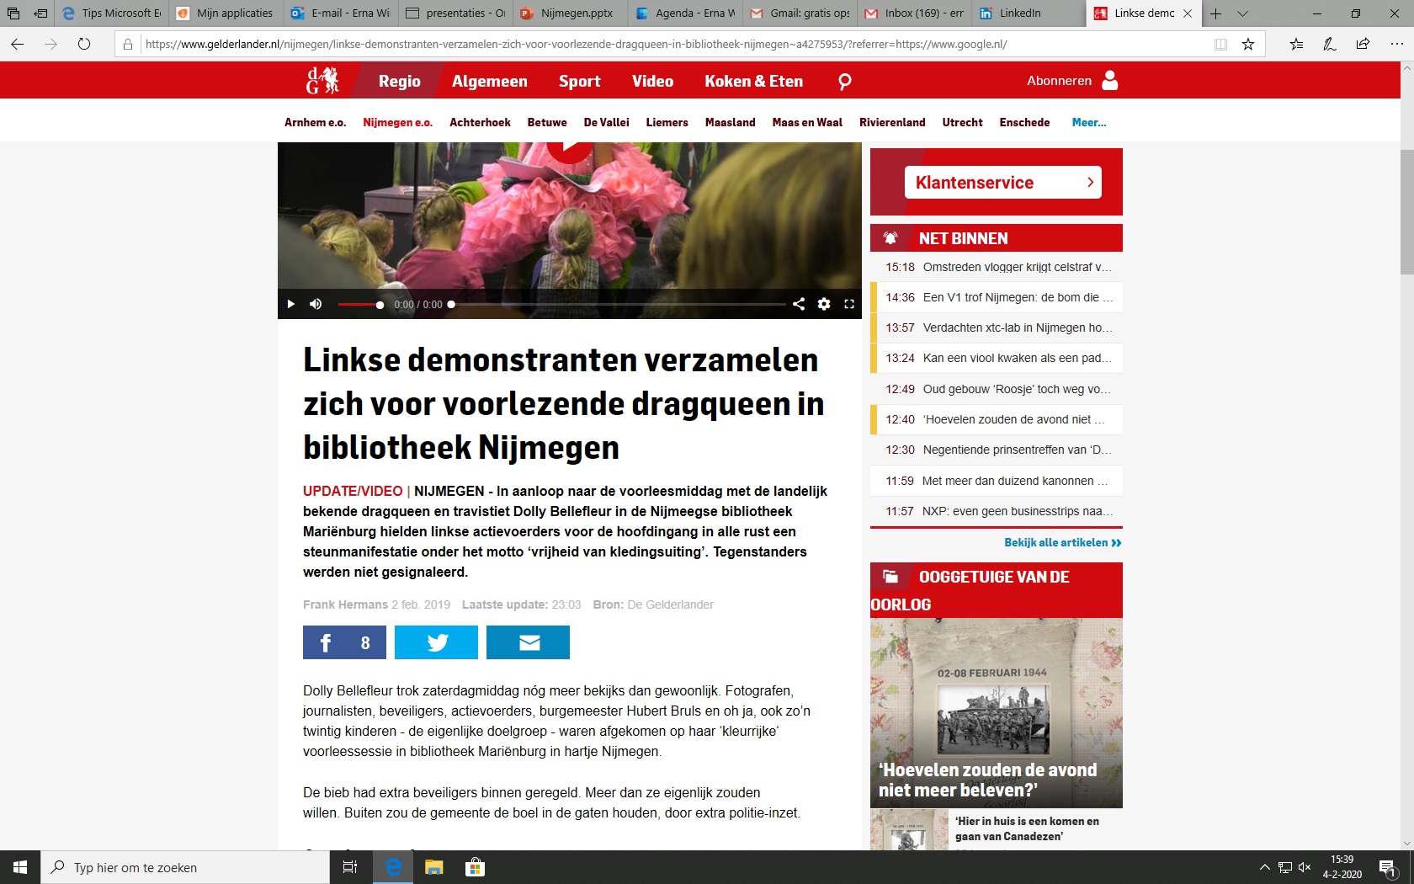

Slide 8

Europese thema's

Slide 9

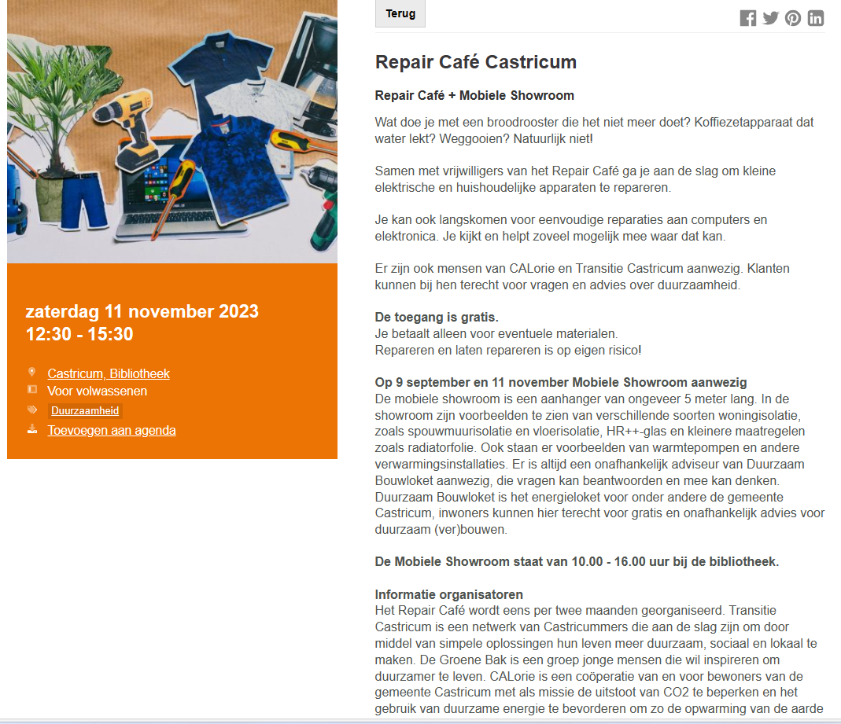
Sustainability

Slide 10
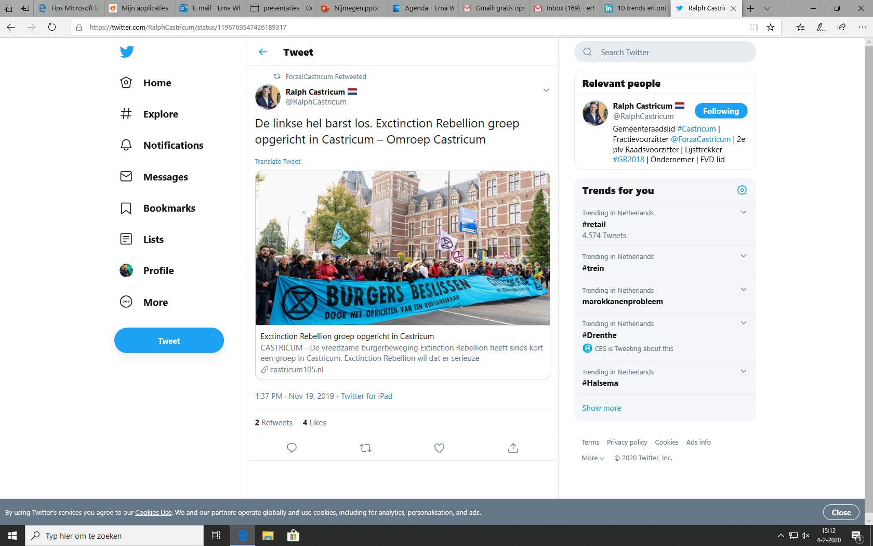

Slide 11
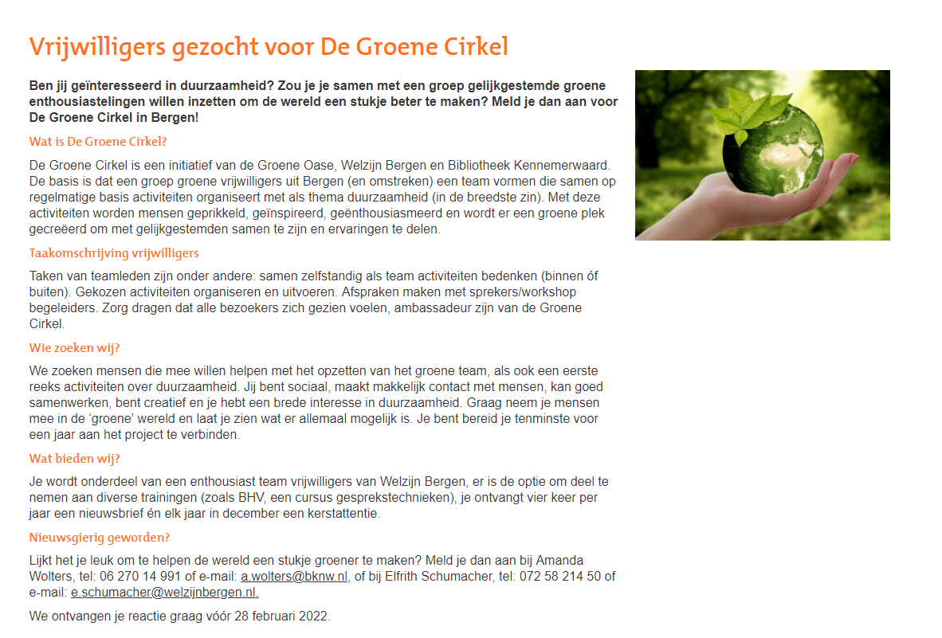

Slide 12
Democratic fitness
10 muscles:
Active listening
Activist
Attitude
Compromise
Courage
Curiosity
Disagreement
Empathy
Mobilization
Verbal confidence
https://www.mehr-demokratie.de/mehr-wissen/demokratische-kultur/demokratie-fitness

Slide 13
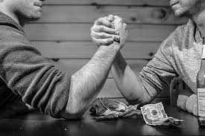
Conflicting interest

Slide 14
Internal conditions to take into account
Courage
Information and discussion internal
Staff with a guerrilla mentality
Confidence
Political awareness
Shared key values such as: independance, ‘neutral’, trustworthy, lawful, support by the whole team
For the staff and the management

Slide 15
The most important title is Citizen:
“citizens -- ordinary men and women, determined to forge their own future -- who throughout history have sparked all the great change and progress." Barack Obama

Slide 16


Slide 17
So which role do you want to play?
“To be neutral in a situation of injustice is to have chosen sides already. It is to support the status quo (…) You have chosen the side of the oppressor” Desmond Tutu

