Slide 1
National library funding scheme
How the Dutch goverment created 46 new libraries and improved 296 public libraries

Slide 2

A new government ready to invest
2022: “We strive to a future oriented public library in each municipality”
Funding for:
New libraries
10 extra opening hours (minimum)
Budget
2023: €17,6 million
2024: €38,4 million
2025+ : €60 million

Slide 3
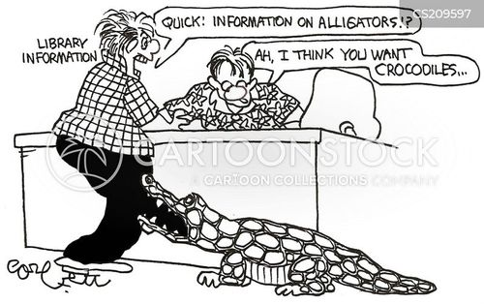
The first question
What does a new library cost?

Slide 4
The scheme
Goals
Create a new library
  Max 400,000,-
Extend opening hours
  Max 200,000,-
Municipalities decide how money is spend
  But it has to go to the local library
Requirements
Proposal of 500 words
  Including budget
Co-financing of 20% by municipality
Activity must be finished in 2 years
Max two applications
  Four for cities with over 200.000 inhabitants

Slide 5
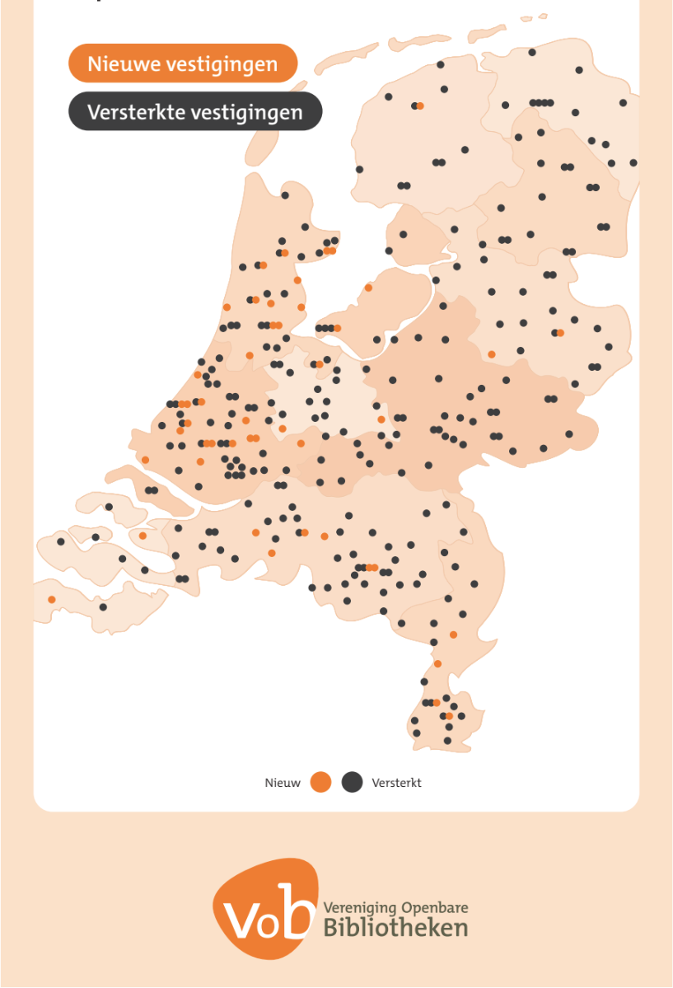
The result
All regions are served
47 new libraries, 300 libraries improved
  In 244 of the 342 Dutch munincipalities
344 applications with the total amount of 65,7 mln euro

Slide 6
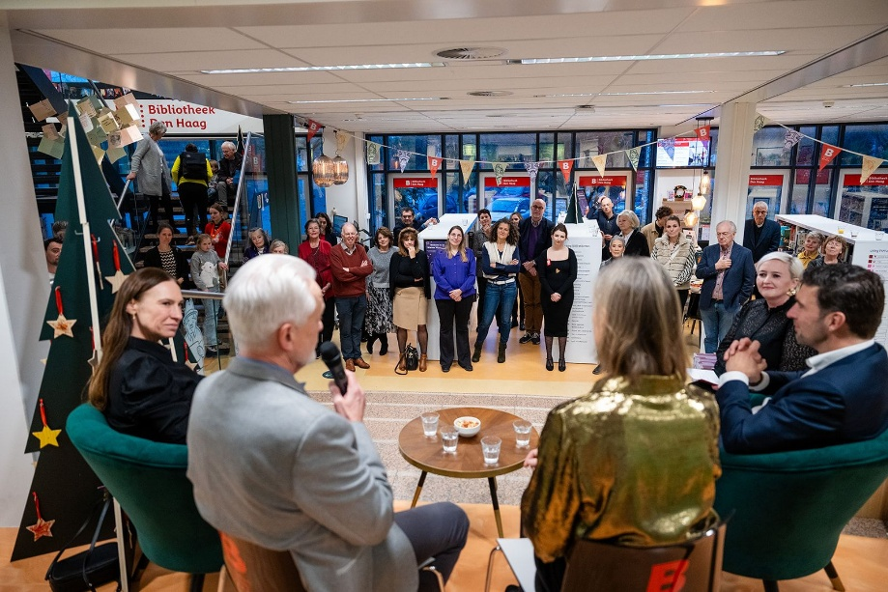
Result after 1 year in 1 new library
The Hague: “The library is a buzzing anker in the heart of the neighbourhood, were young and old, meet, learn, read and enjoy.”
  25.000 loans
  400 new members
  Hundreds of activities

Slide 7
Effects of funding scheme
Rethinking locally how, where and why libraries should be strenghtenened or build.
Physical transformation of public libraries that fulfill multiple roles in local communities
Tapping into needs and wishes of local users; activities, study-corners & meeting places
Many new multifunctional buildings with local partners

Slide 8
Key take aways
Libraries no longer used to investing after decades of cuts
  No plans at hand
Municipalities avoid risks
  No trust in (confirmed) structural funding
  Many applications revoked last-minute
Focus on library building rather then library service
  Clear wish to strengthen the library ‘outside of the building’

